Slide 1
NLP

Slide 2
Introduction to NLP
Introduction to Deep Learning

Slide 3
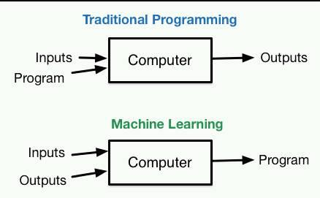
Modern AI Paradigm

Slide 4
Neural Networks
Remember Logistic Regression?
Input: vector of features
Output: classification decision
One-layer LR (maxent model) is a simple Neural Network
Neuron (perceptron): output is a non-linear combination of the inputs

Slide 5
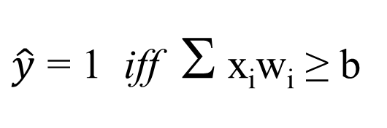
Perceptron
$\hat{y}$ = 1 iff Σ x_{i}w_{i} ≥ b
y
w₁
w₄
w₂
w₃
x₁
x₂
x₃
x₄

Slide 6
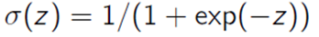
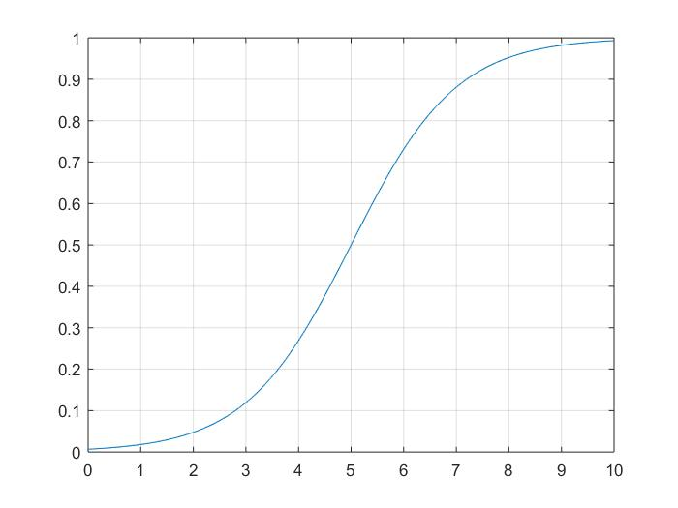
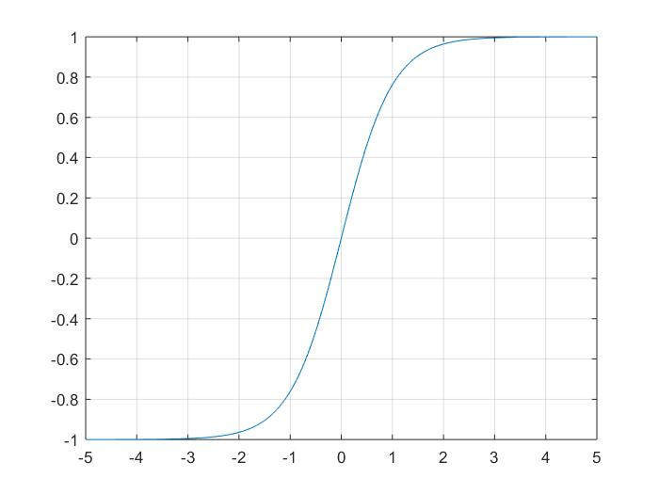
Non-linearities: sigmoid, tanh
Notes:
Jordan, M.I. (1986). Serial order: A parallel distributed processing approach.
LSTM (1997)
Predecessor to CNNs first introduced in 1980, developed in 1988, improved in 1998.

Slide 7
Multi-Layer Perceptron (Multi-layer LR)
z
[output layer]
v₁
v₂
y₁
y₂
[hidden layer]
w_{1,2}
w_{4,2}
w_{2,2}
w_{3,2}
w_{1,1}
w_{2,1}
w_{4,1}
w_{3,1}
x₁
x₂
x₃
x₄
[input layer]

Slide 8
Network with a Hidden Layer
It is a universal function approximator
It can model any continuous function (Hornik 1991)
This is not true for a simpler network
It cannot learn XOR, for example (no one-layer linear classifier can)
The deeper network can represent XOR
as a disjunction of two lower-level features
An even deeper network can also represent an arbitrary function
but with fewer nodes

Slide 9
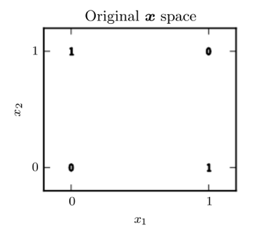
The XOR function
[[0,0], [0]],
[[0,1], [1]],
[[1,0], [1]],
[[1,1], [0]]

Slide 10
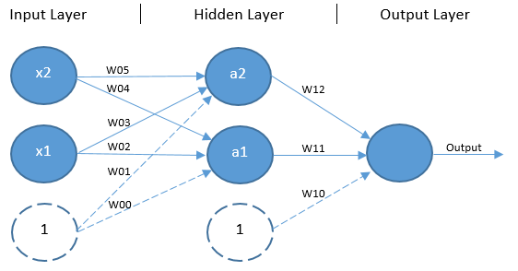
Deep Learning Helps

Slide 11
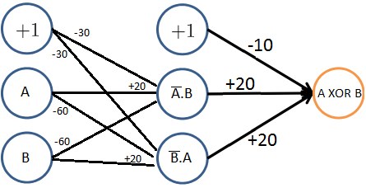
The XOR function
https://www.quora.com/How-can-we-design-a-neural-network-that-acts-as-an-XOR-gate

Slide 12
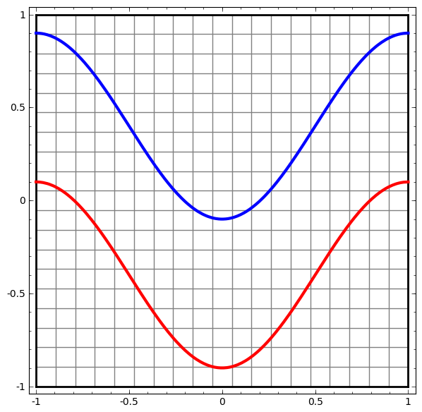
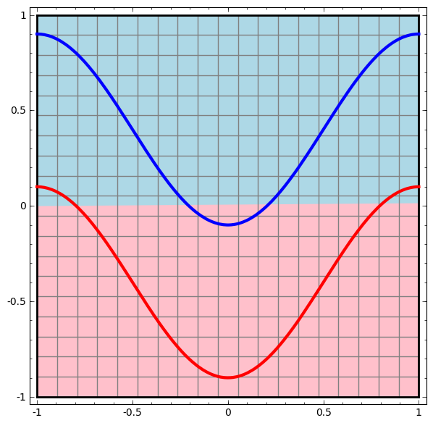
http://colah.github.io/posts/2014-03-NN-Manifolds-Topology/

Slide 13
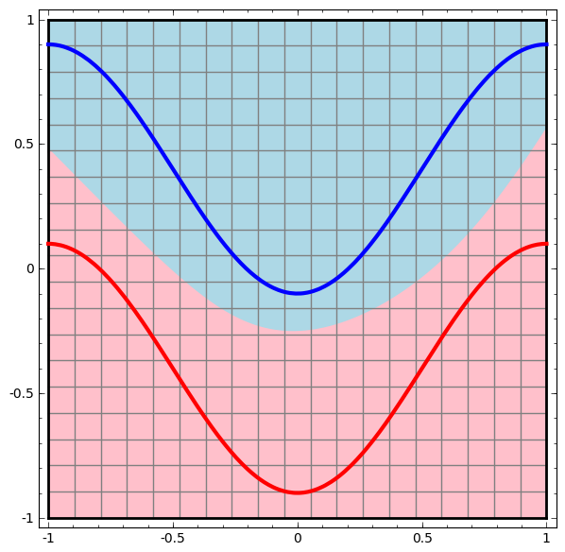
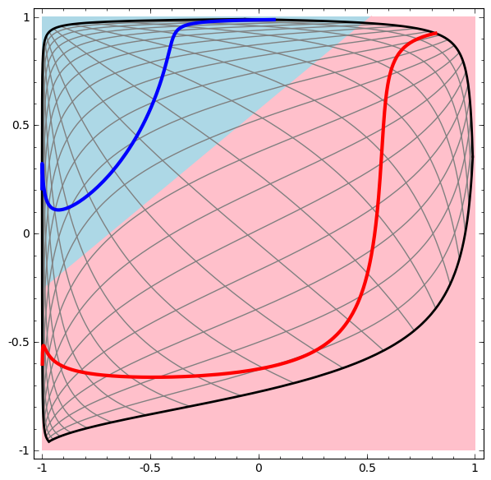

Slide 14
Multi-Layer Perceptron
x2
x1

Slide 15
Deeper Networks
Multiple layers
Input layer
Low-level feature layer
Higher-level feature layer
Output layer
Intuition
Learning features automatically
+
=

Slide 16
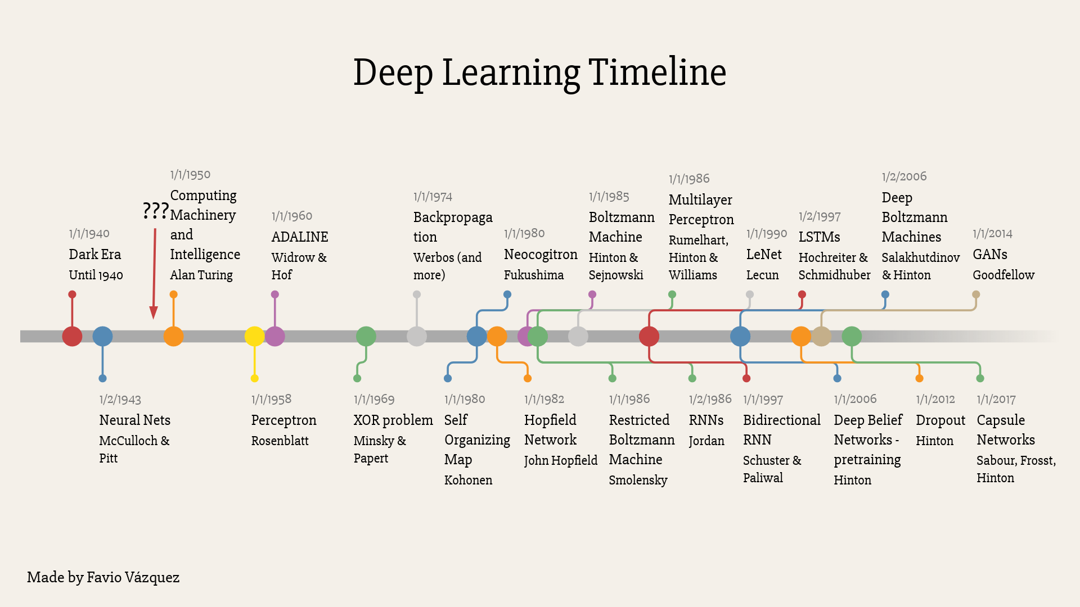

Slide 17
ImageNet
14 M images, manually labeled through crowdsourcing
20,000 categories
https://qz.com/1034972/the-data-that-changed-the-direction-of-ai-research-and-possibly-the-world/

Slide 18
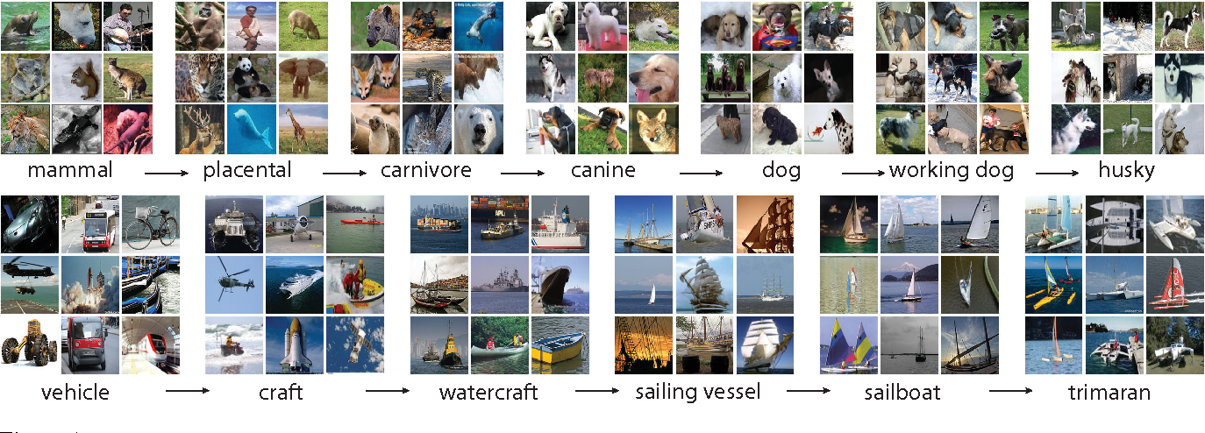
ImageNet
[Image from Deng et al. and Fei-Fei Li 2011]

Slide 19
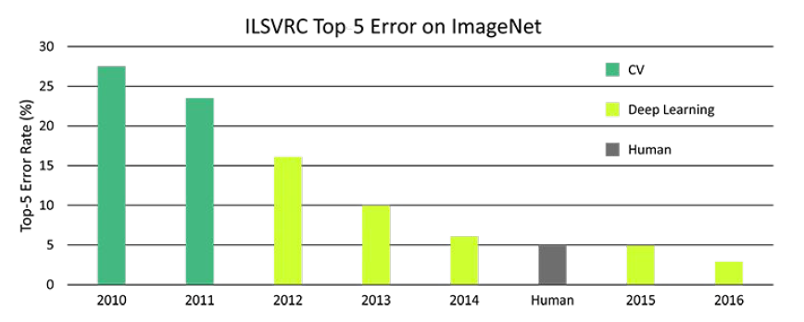
ImageNet Classification Scores

Slide 20
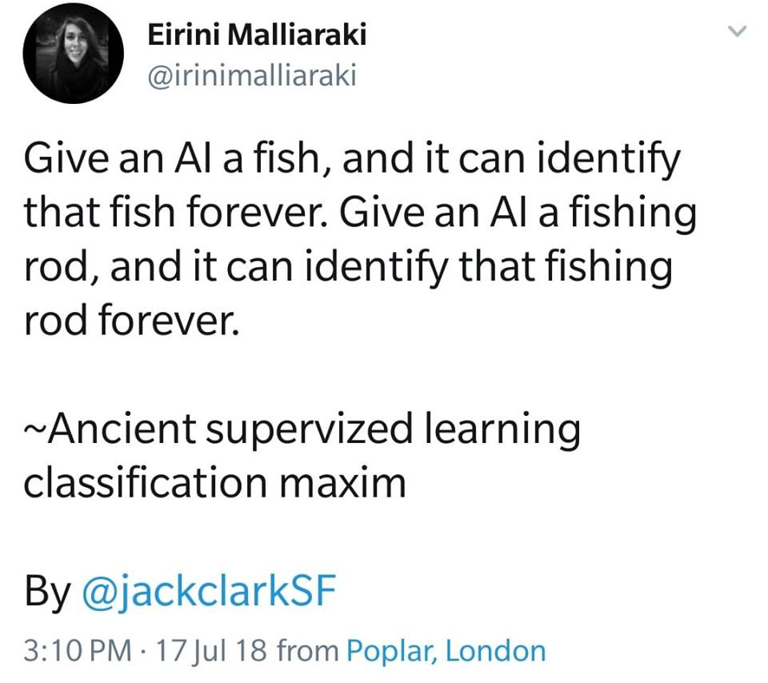

Slide 21
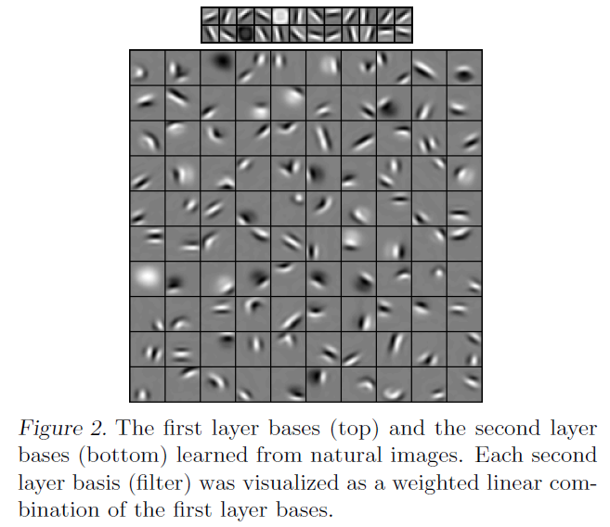
Example (from Lee et al. 2009)

Slide 22
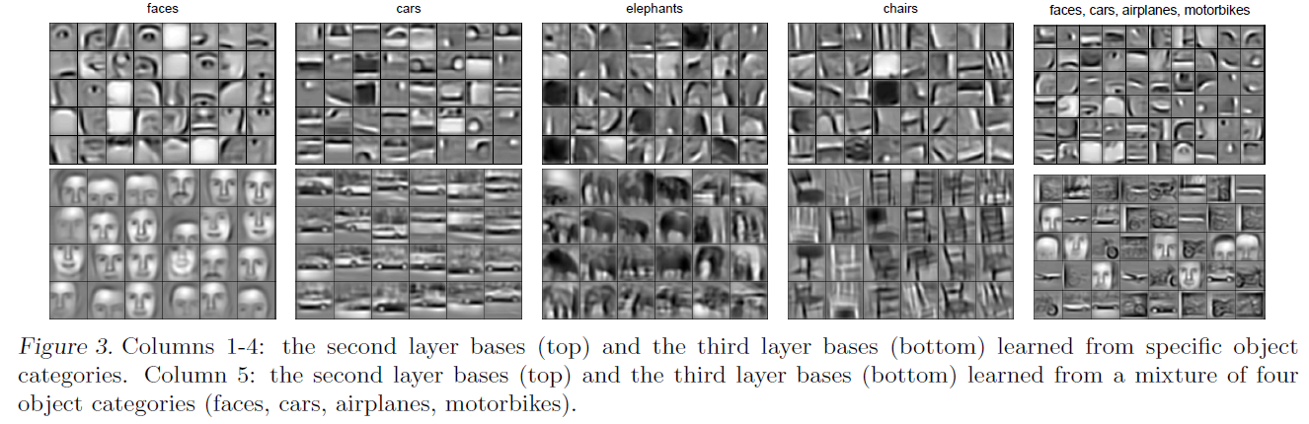
Example (from Lee et al. 2009)

Slide 23
What is Deep Learning
Architecture
Neural Networks with multiple layers
Non-linearities (e.g., sigmoid, tanh)
Use
Single-layer NN used as simple classifier
Multi-layer NN can express more complex functions and learn complex features
Hot area of research
Very popular these days, especially in speech and vision, but also in NLP
Works best with high-performance computers using GPUs and very large data sets

Slide 24
Why Deep Learning?
Amazing results
Speech: Dahl et al. 2010 – 30% improvement in WER (word error rate)
Vision: ImageNet (Krizhevsky et al. 2012) – scarily complex architecture
The big players (Google, Facebook, Baidu, Microsoft, IBM…) are investing billions in DL
The hot new thing?
Actually, many of the architectures that we’ll talk about were invented in the 1980s and 1990s
What’s new is hardware (GPU) that can use these architectures at scale
Notes:
Jordan, M.I. (1986). Serial order: A parallel distributed processing approach.
LSTM (1997)
Predecessor to CNNs first introduced in 1980, developed in 1988, improved in 1998.

Slide 25
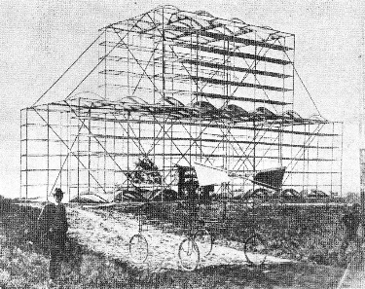

Slide 26
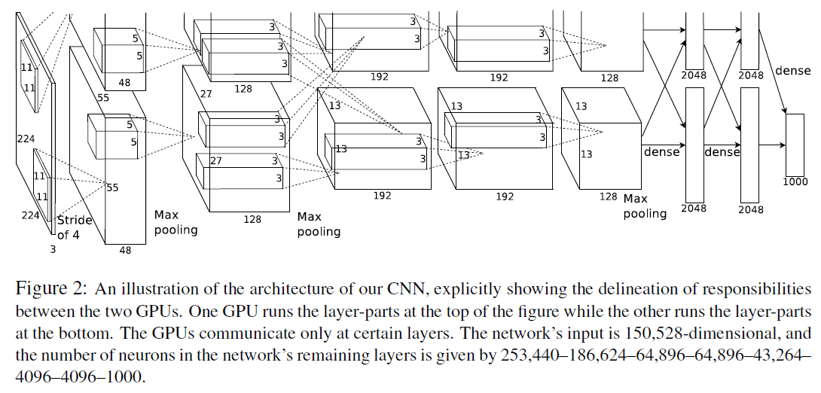
ImageNet Architecture

Slide 27
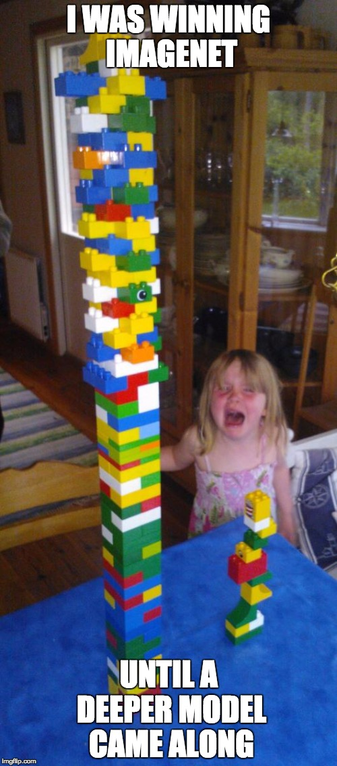

Slide 28
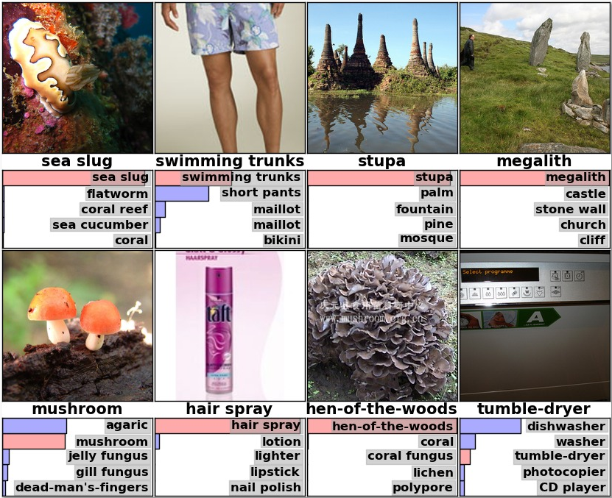
[Krizhevsky et al. 2012]

Slide 29
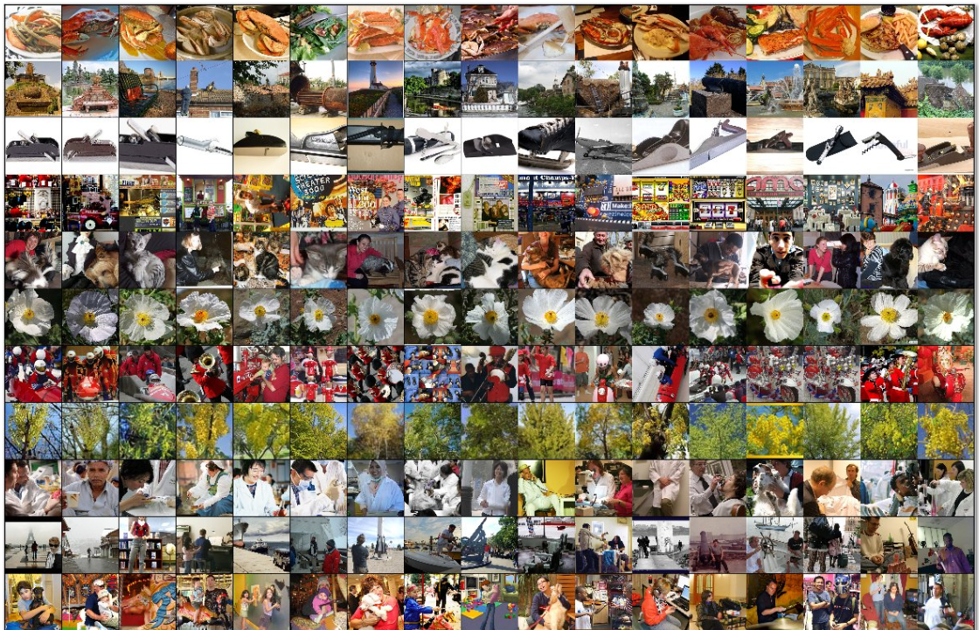
[Krizhevsky et al. 2012]

Slide 30
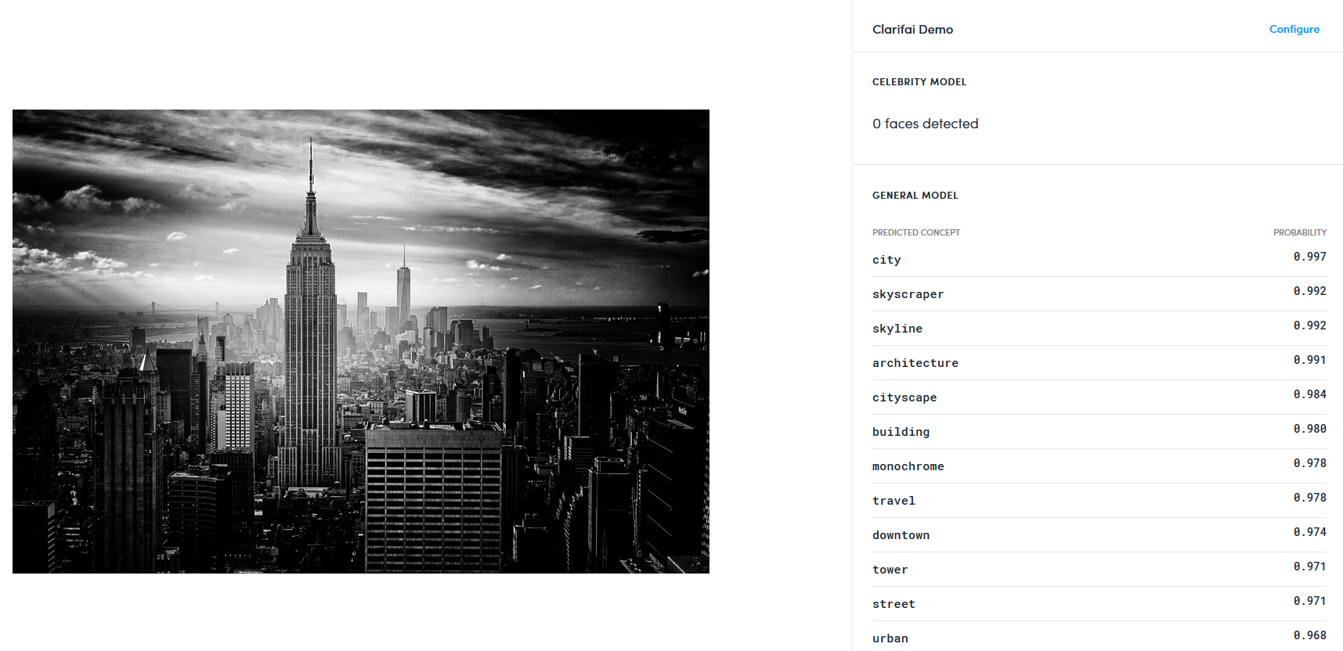
[clarifai.com demo]

Slide 31
Autoencoder
z₁
z₂
z₃
z₄
[output layer]
z = x
y₁
y₂
[hidden layer]
x₁
x₂
x₃
x₄
[input layer]

Slide 32
Autoencoder
The size of the hidden layer should be smaller than the size of the input layer.
Otherwise the hidden layer will learn the identity mapping
Minimize loss
difference between z_{i} and x_{i}
Denoising autoencoder
Add some domain-independent noise to the input
Example: rotate or stretch the image
Still try to have the output match the input
The autoencoder is closely related to SVD

Slide 33
Quick Math Review
This equation
3
x
2
y
5
z
7
3
x
2
y
5
z
can be written as a dot product of two vectors:
x
7
3
2
5
y
z

Slide 34
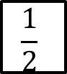
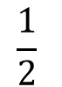
Linear Algebra
Likewise, these equations
3
x
2
y
5
z
7
-1
x
3
y
9
z
12
4
x
$$\frac{1}{2}$$
y
0
z
8
can be written as a dot product of a matrix and a vector:
3
2
5
x
7
-1
3
9
y
12
4
$$\frac{1}{2}$$
0
z
8

Slide 35
Supervised Machine Learning
Parameters
(things we're learning)
w
Input feature vector
x
Sigmoid or other nonlinearity
σ
ŷ
Predicted
value

Slide 36
Supervised Machine Learning
w
x
Update parameters
σ
How wrong were we?
cost( , )
ŷ
y
Actual
value

Slide 37
A Simplified Diagram
x
w
σ
y

Slide 38
Gradient Descent Example
Starting value
w = (1,-1,-2,3)
accuracy 66%
Next value
w = (2,-2,-1,2)
accuracy 73%
Next value
w = (3,-2,-1,4)
accuracy 80%
etc.

Slide 39
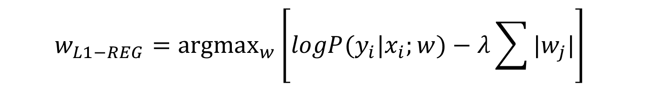
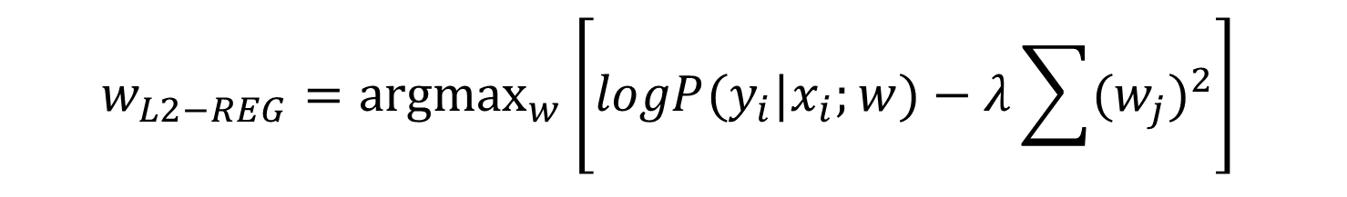
Regularization
Penalize large weights (we don’t want weights of 500,000)
L₂ regularizer
L₁ regularizer
$$w_{L2−REG}={\text{argmax}}_{w}{\left[logP(y_{i}|x_{i};w)−λ\sum{{(w_{j})}^{2}}\right]}_{ }$$
$$w_{L1−REG}={\text{argmax}}_{w}{\left[logP(y_{i}|x_{i};w)−λ\sum{|w_{j}|}\right]}_{ }$$

Slide 40
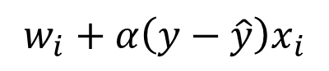
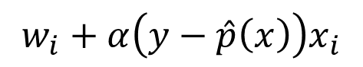
Stochastic Gradient Descent
Batch mode
Consider each data point for each update of w
This is slow
Stochastic mode
Update w after each data point
Logistic regression stochastic update (p is between 0 and 1)
Perceptron stochastic update (y is 0 or 1; approximation for LR)
$$w_{i}+α\left(y−\hat{p}\left(x\right)\right)x_{i}$$
$$w_{i}+α\left(y−\hat{y}\right)x_{i}$$

Slide 41
Training Process
Computational Graphs
Specify network structure
Describe the loss function
Provide training data
Set hyperparameters
Training/Backpropagation
For each epoch
For each batch (size 1-100)
Compute loss
Autograd: compute gradients
Prediction/Forward Propagation
(Decoding)

Slide 42
Computational Graphs
[Example from Vivek Srikumar]

Slide 57
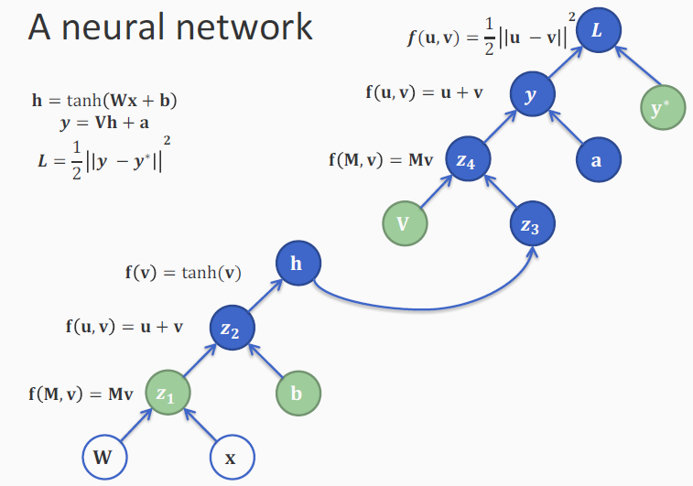

Slide 59
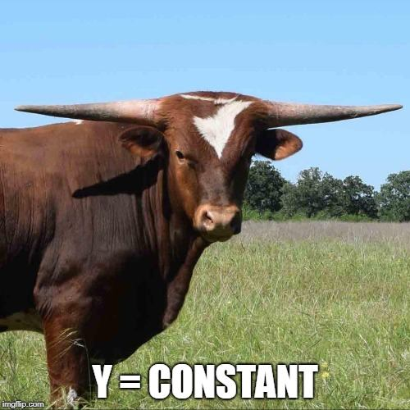
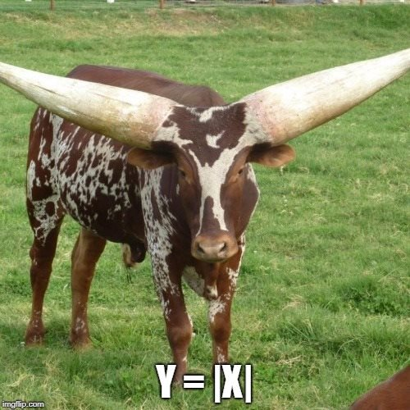
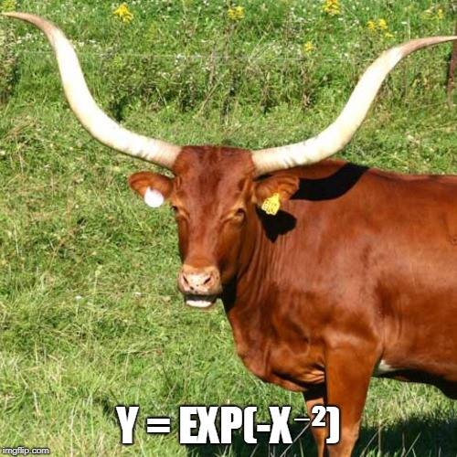
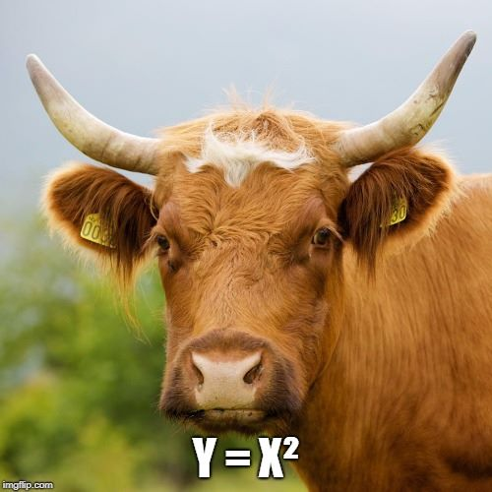
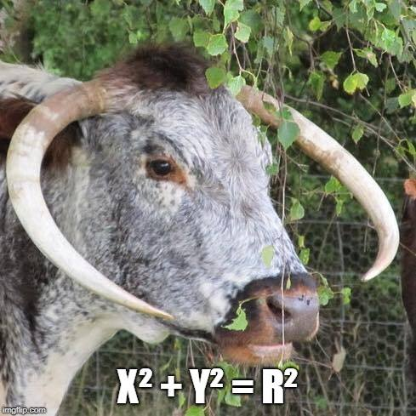
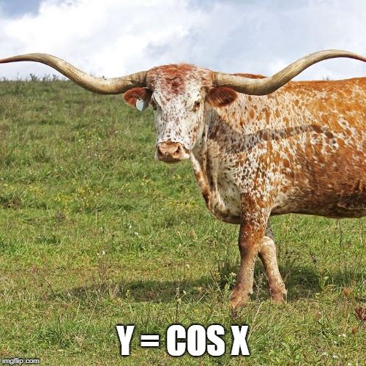
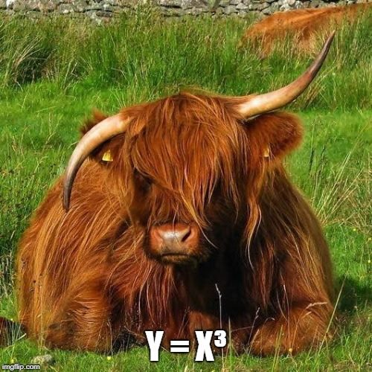
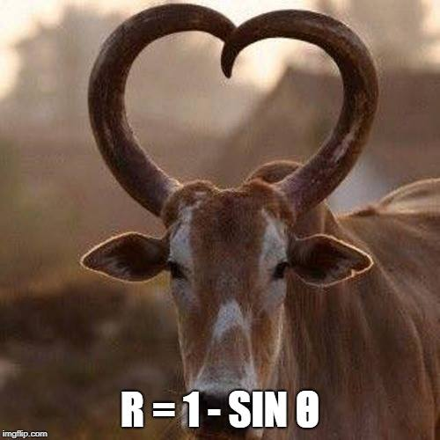

Slide 60
Notes
Dropout
Stochastically set some values to zero during training
A form of regularization
One line of code in pytorch
Optimization
Variants: e.g., adaptive/adagrad
Optional link:
https://towardsdatascience.com/types-of-optimization-algorithms-used-in-neural-networks-and-ways-to-optimize-gradient-95ae5d39529f

Slide 61
NLP

